Slide 1
BITS ZG553: Real Time Systems L16 – Uncertainties in RTS & Fault-Tolerance Techniques
K G Krishna
WILP Division, BITS-Pilani, Hyderabad

Slide 2
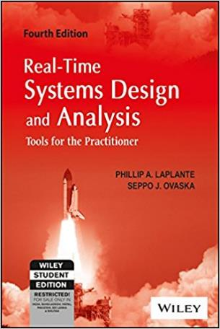
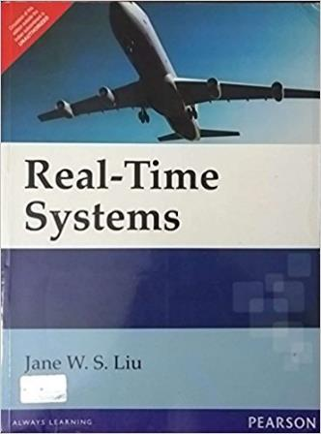
Text Book / References
Reference (R1)
Text Book (T1)
Note: As the above two books focus on theoretical treatment of the subject, Students are strongly advised to refer to web sources / MOOCs videos / library within their own organizations for more practical understanding of the topics.

Slide 3
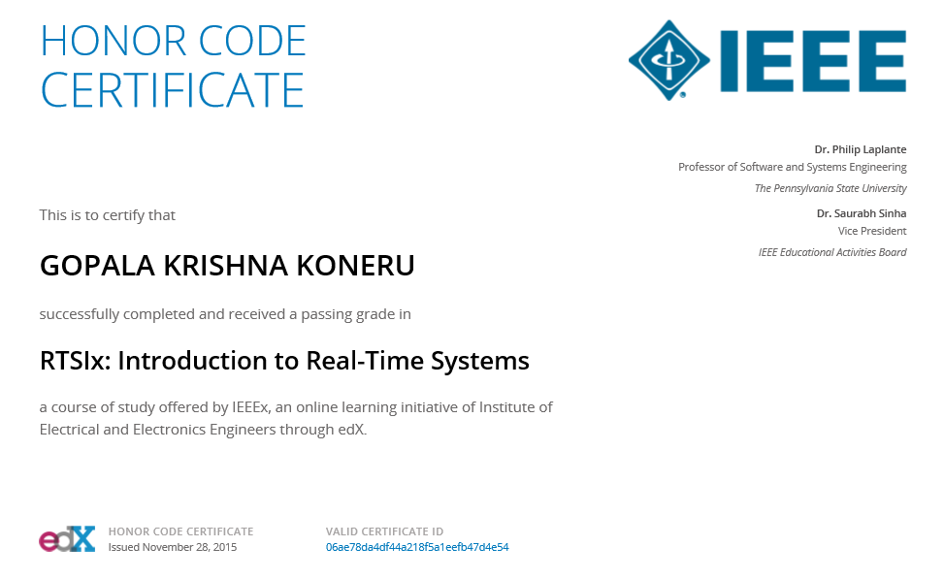
Excellent MOOCs Videos
(Coursera, edX,…)

Slide 4
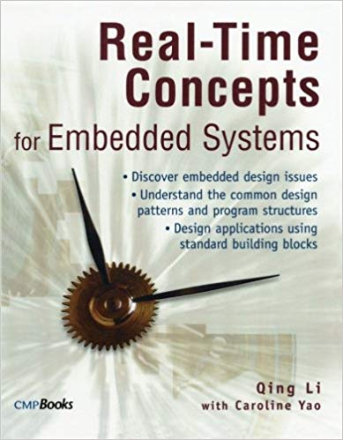
RTS Primer – For Light Reading

Slide 5
L-16: Uncertainties in RTS & Fault-ToleranceTechniques
[Ref: Notes/PPT]
Note: Students are requested to NOT to rely on PPTs/Recorded sessions as their only source of knowledge, explore sources within your own organization or web for any specific topic; attend classes regularly and involve in discussions;
PLEASE DO NOT PRINT PPTs, Save the Environment!
Source PPT Courtesy: Some of the contents of this PPT is sourced from Presentatoons of Prof K R Anupa / Prof B Mishra, BITS-Pilani WILP Division

Slide 6
Introduction
Focus of real-time system design is shifting from meeting mere performance goals to designing for uncertainty
Uncertainty exists in embedded systems along 3 dimensions – Time, Space and Behaviour.
Time:
Main of the challenge in design of embedded systems is unpredictability of response time.
RM Algorithm produces a deterministic schedule only when sporadic tasks, aperiodic tasks, mutual exclusion and resource contention are excluded.
Space:
Space dimension deals with the limitation posed by physical resources like memory.
Behaviour
Component behaviour, environmental behaviour (such as inputs, outputs), state, uncertainty of requirements, uncertainty in testing etc.

Slide 7
Introduction
Heisenberg Uncertainty Principle:
The precise position and momentum of a particle can’t be known precisely; trying to be more certain about one comes at the expense of increased uncertainty of others.
Similarly, in case of real-time systems, trying to bring more certainty in once dimension, bring uncertainty to other dimensions.
Space
Uncertainty
Margin
Real-Time System
Time
Behaviour

Slide 8
Sources of Uncertainties
Kind of Uncertainties | Signs | Possible Causes | Possible Solutions
System under control | Bizarre inputs; Bizarre outputs; | Nature of application; Faulty hardware | Use aggressive fault tolerant design
Operating environment | Bizarre inputs; Bizarre outputs; | SEUs, sand, salt, shock, etc. | Use aggressive fault tolerant design
Requirements | Sparse requirements; Numerous “TBDs” | Incomplete requirements; Inconsistent requirements | Goals based requirements analysis; formal consistency checking
Testing | System that passes testing fails in the field | Poor testing regimen; Incomplete coverage | Improve testing process
Input | Strange behavior; Explicating comments | Unstable input sources; Defective hardware | Kalman filters, data fusion, median filters or averaging, roll back and recovery blocks.
Output | Strange behavior; Explicating comments | Defective hardware; Corrupted inputs from SUC | Kalman filters, data fusion, median filters or averaging, roll back and recovery blocks.
State | Strange behavior; Explicating comments | Program code jumping; Pointer errors | Model checking; Software black boxes

Slide 9
Sources of Uncertainties
Kind of Uncertainties | Signs | Possible Causes | Possible Solutions
Timing and schedulability | Dubious constraints; Missed deadlines; Explicating comments | Delays as loops; Speculative generality; Failed off-the-shelf components | Use OS provided timer facilities; Model checking; Fault injection
Programming Language & Compiler | Explicating comments; | Compiler induced errors | Test the compiler; Improve coding techniques
Off –the-shelf components | Missed deadlines; Inexplicable failure; | Badly tested software or hardware; Falsely advertised claims | Fault injection; Software black boxes
Execution Time | Missed deadlines | Gradual build up of various truncation and round-off errors | Rejuvenation (stopping and restarting the system regularly – should be used cautiously

Slide 10
Fault Tolerance Techniques

Slide 11
Faults and Their Sources
Fault is an erroneous state of software or hardware resulting from failures of its components
Fault Sources
Mechanical --“wears out”
Deterioration: wear, fatigue, corrosion
Shock: fractures, overload, etc.
Electronic Hardware --“bad fabrication; wears out”
Latent manufacturing defects
Operating environment: noise, heat, ESD, electro-migration
Design defects (Pentium F-DIV bug)
Software --“bad design”
Design defects
“Code rot” --accumulated run-time faults
System Misuse – “people”

Slide 12
Faults Classifications
Failure:
Component does not provide service
Fault:
A defect within a system
Error:
A deviation from the required operation of the system or subsystem

Slide 13
Reliability
A measure of whether a user can depend on the system.
The system “stands the test of time.”
There is an absence of known catastrophic errors; that is, errors that render the system useless.
The system recovers “gracefully” from errors.
The software is robust.
For real-time systems, other informal characterizations of reliability might include
Downtime is below a certain threshold.
The accuracy of the system is within a certain tolerance.
Real-time performance requirements are met consistently.
Traditionally, MTFF (Mean Time To First Failure) and MTBF (Mean Time Between Failures) are used as a measure of Software Reliability.

Slide 14
Reliability – Statistical Perspective
Let S = The system
T = Time instance of fault
Then Reliability of S at any time instance t, is defined by
R(t) = P(T > t) i.e. Probability of not having any fault till time t.
R(t) = 1 is the ideal case. Practically, r(t) is less than 1.
Example:
In the monitoring system of a nuclear power plant, the failure probability is no more than 10⁻⁹ per hour.
So, R(t) = (1 - 10⁻⁹)^{t}, t is in hours.
So, as t->∞, r(t) -> 0.

Slide 15
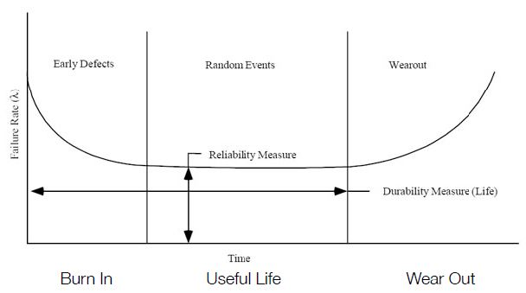
Component Reliability Model

Slide 16
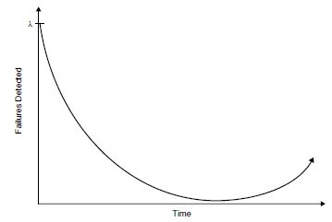
Software Reliability – Statistical Perspective
Failure function tends to become a bathtub curve i.e. failures reduces initially at an exponential rate, but increases towards the end.
Source: P. A. Laplante, Real-Time Systems Design and Analysis, Wiley, 3rd edition

Slide 17
Software Reliability – Statistical Perspective
Reasons for Bathtub curve for failures:
Hardware can wear and tear. So after some point of time, the number of failures increases.
But software can’t wear and tear. Then why bathtub curve for the software ?
During patch releases, making quick correction without designing them properly.
During patch releases, ignoring the effect of the new bug fix on other modules (thereby fixing one issue and introducing more new issues)
Inadequate testing of the software during patch releases.
Wear and tear of underlying hardware.

Slide 18
Serial and Parallel System Reliability
Serial Component Probability
Let there are n serially connected components, with reliability of R_{k}(t) for kth component
Then total system reliability,
Parallel Component Probability
If there n parallel connected components , with reliability of R_{k}(t) for kth component
Then total failure probability,
So total reliability,
So, reliability increases with parallel components

Slide 19
What is Fault Tolerance ?
Fault Tolerance in real-time system is the tendency to continue functioning in the presence of hardware or software failures.
Two Types:
Spatial Fault Tolerance: Includes methods involving redundant hardware and/or software solutions
Temporal Fault Tolerance: Involves miscellaneous techniques that allow for tolerating missed deadlines

Slide 20
Methods to increase fault tolerance
Voting schemes
Software Check Points
Software Black Boxes
Built-in-Test Software
CRC check
Hamming code error detection and correction
Handling Spurious and Missed Interrupts

Slide 21
Voting Schemes
Combine input from two or more process blocks (hardware or software) and combine in some manner
Voting schemes use majority rule or average of block outputs to obtain final values
P1, P2 and P3 processors execute different versions of the code for the same application (usually developed by different teams).
Voter compares the results and forward the majority vote of results (two out of three).
P1
Input
P2
Voter
P3

Slide 22
Software Check Points
Intermediate results are dumped at fixed locations for diagnostic purpose
Can be used during verification or regular operation
If used during testing only then this additional code is called a test probe

Slide 23
Recovery Blocks
Fault tolerance is increased by using checkpoints with predetermined reset points in the software.
These reset points mark recovery blocks
At the end of each recovery block, the corresponding check point is tested.
If the results are not reasonable, then the processing resumes with a prior recovery block.
Code Unit
n
Code Unit n+1
Test Data Reasonable
Checkpoint Test Data from Code Unit n
Test Data Is Not Reasonable

Slide 24
N-Version Programming
Used to increase software fault tolerance
Generally redundant processors are used.
Same software developed by different teams using different algorithms runs on these redundant processors.
In case one such software locks-up, then the system can ignore this software and go ahead with the other software which is functioning correctly on different processors.
This is called N-Version programming.
Generally this method is used mission-critical systems like the space shuttle’s general purpose computer.

Slide 25
Built-in-Test Software (BITS)
Can increase fault-tolerance in presence of hardware errors
CPU Tests
Memory Tests (ROM and RAM)
Other Devices

Slide 26
BITS – CPU test
Perform carefully constructed set of tests
Must be performed with interrupts disabled
Too slow to perform in foreground

Slide 27
BITS – Memory test
All kind of memory can be corrupted via electrostatic discharge, power surging, vibration or other physical means
Corruption of memory devices by randomly encountered charge particles is a particular problem in space.

Slide 28
ROM check – using CRC
CRC – Cyclic Redundancy Code
CRC value of each memory is stored and checked when data from the memory is used
CRC Calculation
Treats memory as a long binary polynomial
Divide polynomial by generator polynomial
X¹⁶+X¹²+X⁵+1 (CCITT)
X¹⁶+X¹⁵+X²+1 (CRC-16)
Remainder is CRC

Slide 29
3-bits CRC Example
Generator polynomial: x³+x+1
= 1x³+0x²+1x+1
So generator polynomial is represented as 1011
Let the input polynomial is 11010011101100.
Pad the input polynomial by 3 bits (3 bits CRC) : 11010011101100000
Divide 11010011101100000 by 1011:
Essentially x-or the 4 bits of input polynomial with 4 bits of generator polynomial starting from left bit. Then move the generator polynomial to the next 1 of the result.

Slide 30
3-bits CRC Example (contd.)
11010011101100 000 <--- input right padded by 3 bits
1011 <--- divisor
01100011101100 000 <--- result (note the first four bits are the XOR with the divisor beneath, the rest of the bits are unchanged)
1011 <--- divisor ...
00111011101100 000
1011
00010111101100 000
1011
00000001101100 000 <--- note that the divisor moves over to align with the next 1 in the dividend (since quotient for that step was zero)
1011 (in other words, it doesn't necessarily move one bit per iteration)
00000000110100 000
1011
00000000011000 000
1011
00000000001110 000
1011
00000000000101 000
101 1
-----------------
00000000000000 100 <--- remainder (3 bits). Division algorithm stops here as quotient is equal to zero.
So, CRC is 100

Slide 31
RAM Check – using EDC
CRC is not suitable for RAM, since RAM content is volatile
A Hardware circuit implementing some Hamming code error detection and correction (EDC) is used
During normal data access, the data must pass through the EDC hardware before into or out of the memory
The hardware compares the data against the check bits and makes necessary corrections if necessary.

Slide 32
Spurious and Missed Interrupts
Spurious Interrupts
Spurious (or phantom) Interrupts are the extraneous and unwanted interrupts.
Caused by noisy hardware, power surges, electrostatic discharges etc.
They can destroy algorithmic integrity, stack overflows, compromise the deadlines etc.
Such interrupt can be tolerated by
Having redundant interrupt hardware
The device issuing the interrupt can issue a redundant check like
Using DMA to send a confirming flag.
Then the device receiving the interrupt can check if this flag upon receiving it.
Missed Interrupts
Missed interrupts are more difficult to deal with.
They can be tolerated by robust algorithms

Slide 33
Watchdog Timer
A watchdog timer is used to automatically detect software anomalies and reset the processor if any such anomaly occur.
It is a timing device such that it is set for a preset time interval and an event must occur during that interval else the device will generate the timeout signal on failure to get that event in the watched time interval
Watchdog timer can be
A Hardware
A Software task
A simple watchdog timer example:
Watchdog timer is based on a counter that counts down from some initial value to zero.
The embedded software selects the counter's initial value and periodically restarts it.
If the counter ever reaches zero before the software restarts it, the software is presumed to be malfunctioning and the processor's reset signal is asserted.
Another Example:
Assume that we anticipate that a set of tasks must finish in 100 ms interval.
The watchdog timer is disabled and stopped by the program instruction in case the tasks finish within 100 ms interval.
In case task does not finish (not disabled by the program instruction), watchdog timer generates interrupts after 100 ms and executes a routine, which is programmed to run because there is failure of finishing the task in anticipated interval.

Slide 34
Thank You.
Any Questions?

